Slide 1
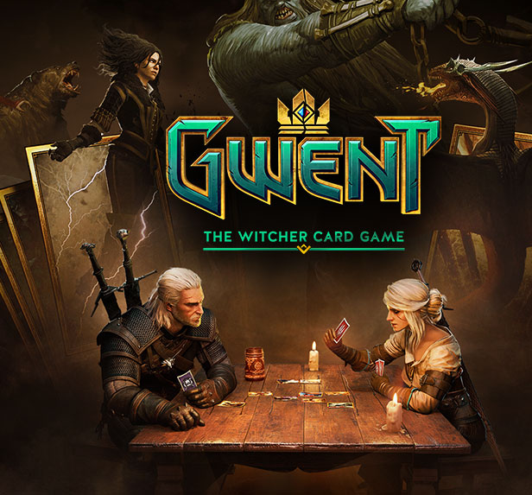
Gwent
By Nick DePaul

Slide 2
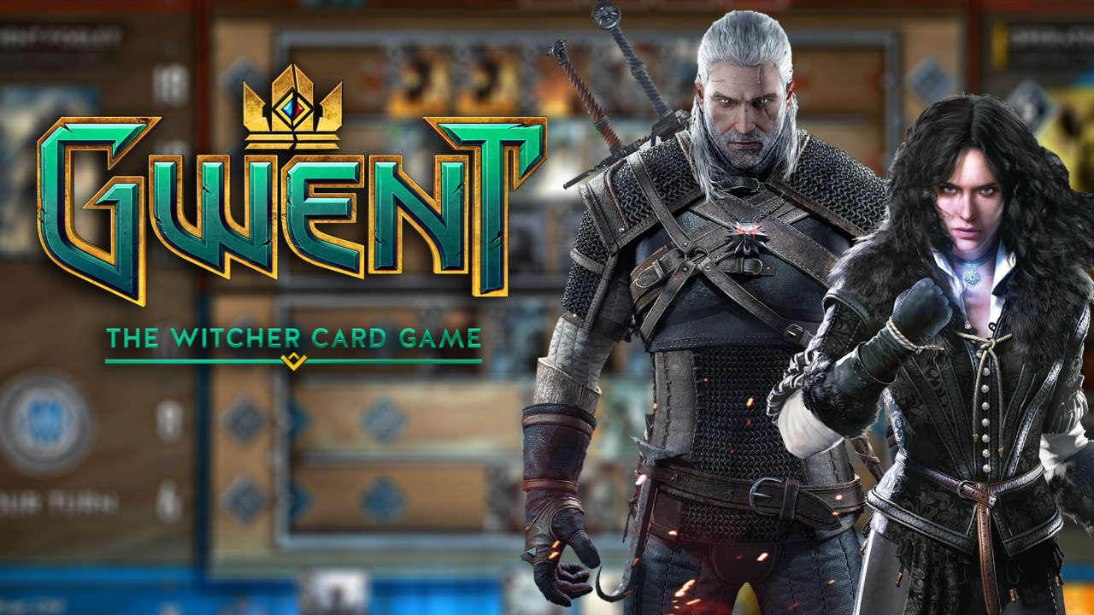
Table of Contents
Executive Summary 3
Entity Relationship Diagram 4
Tables 5
Reports 28
Views 39
Stored Procedures 44
Triggers 46
Security 48
Implementation Notes 50
Known Problems / Future Enhancements 55

Slide 3
Executive Summary
Gwent is an online card game that utilizes the world of The Witcher, created by CD Projekt Red. In Gwent, each player has a collection of cards that they collect through in game currencies, like orens, or scrap. Players compete against each other in a best of three format, using decks created from cards in their collections. Every day Gwent will keep track on how many rounds the player has won, at the end of the day it will reset. Based on how many rounds you win, you will receive a reward of scraps that you can use to either craft more cards or open a card pack. Gwent maintains its long-term appeal by containing a variety of cards with different effects; these cards are further separated by factions, each of which has leaders with special abilities that allows each faction to have a different play style. As such, cards can be restricted as being in a faction, or available to all the factions. The database needs to record the effects of individual cards, including; health, effects, card artists, and flavor text. This Database is made to serve as a portrayal of the CD Projekt Red game, Gwent. It will provide an approximation of the fields that are required for the basic mechanics of the game, including the use of minions and special cards. The database will need to contain different cards, decks, collections possessed by players, leader, factions, credit card information, player information, and daily quests.

Slide 4
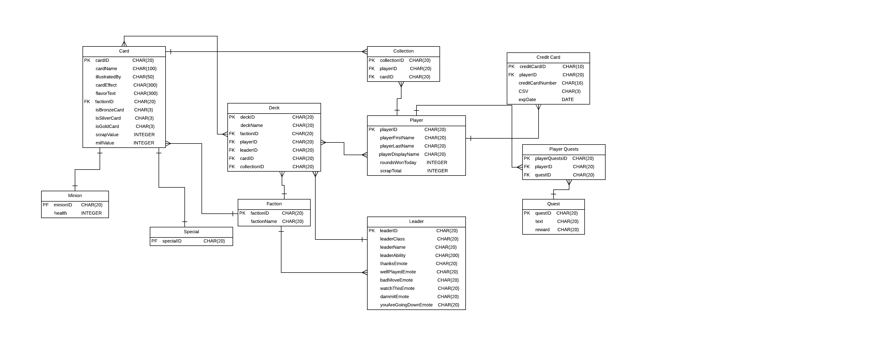
Entity Relationship Diagram

Slide 5
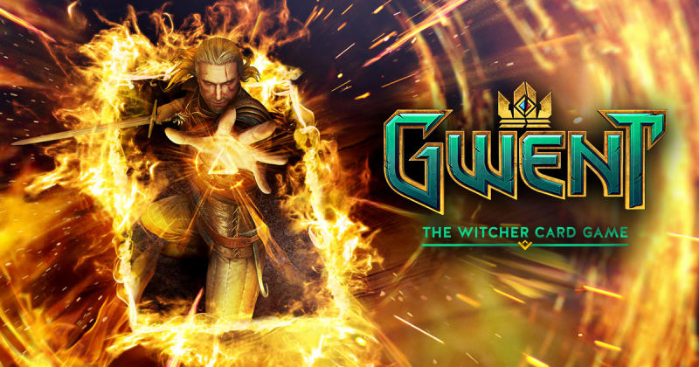
Tables

Slide 6
Card
CREATE TABLE Card (
cardID CHAR(20),
cardName CHAR(100),
illustratedBy CHAR(50),
cardEffect CHAR(300),
flavorText CHAR(300),
factionID CHAR(20),
isBronzeCard CHAR(3),
isSilverCard CHAR(3),
isGoldCard CHAR(3),
scrapValue INTEGER,
millValue INTEGER,
PRIMARY KEY(cardID)
);

Slide 7

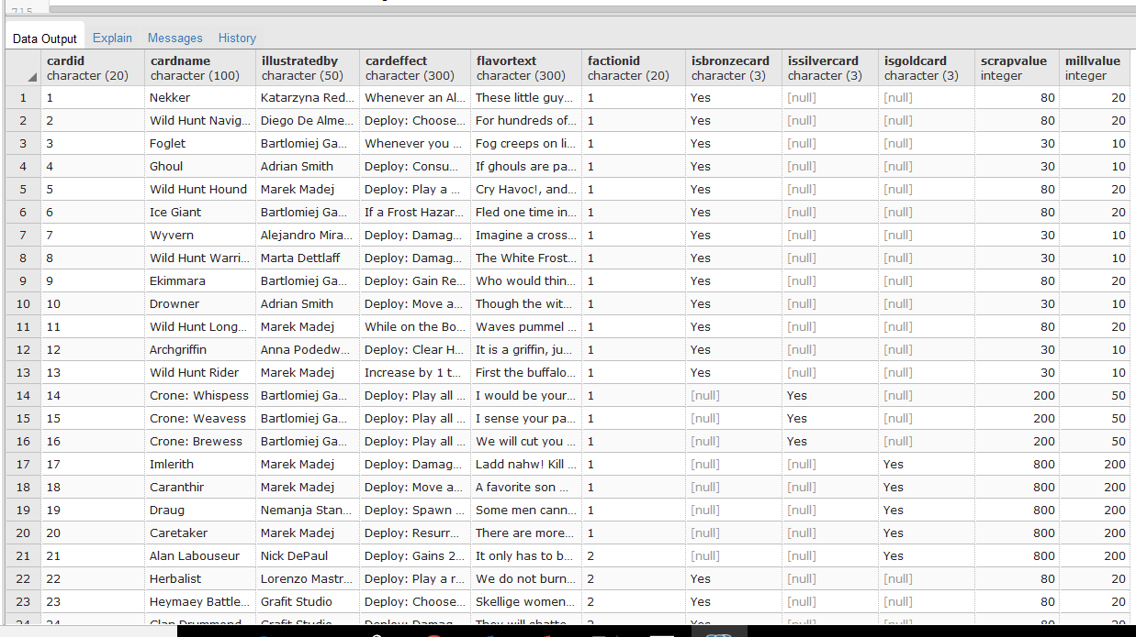

Slide 8
Minion
CREATE TABLE Minion (
minionID CHAR(20),
health INTEGER,
PRIMARY KEY(minionID)
);

Slide 9
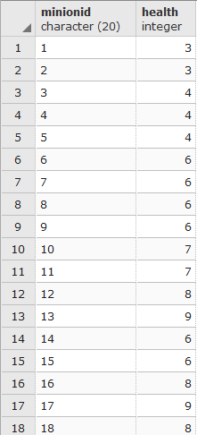

Slide 10
Special
CREATE TABLE Special (
specialID CHAR(20),
PRIMARY KEY(specialID)
);

Slide 11
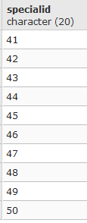

Slide 12
Deck
CREATE TABLE Deck (
deckID CHAR(20),
deckName CHAR(20),
factionID CHAR(20),
playerID CHAR(20),
leaderID CHAR(20),
cardID CHAR(20),
collectionID CHAR(20),
PRIMARY KEY(deckID)
);

Slide 13
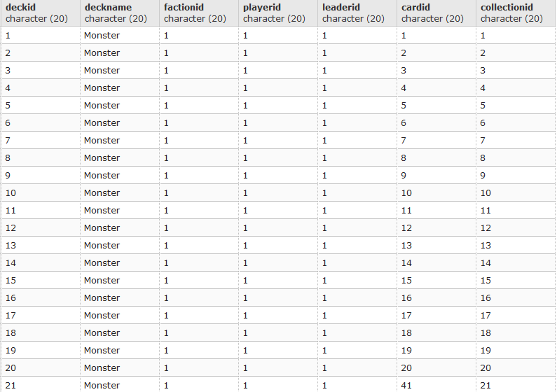

Slide 14
Faction
CREATE TABLE Faction (
factionID CHAR(20),
factionName CHAR(20),
PRIMARY KEY(factionID)
);

Slide 15
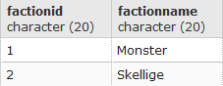

Slide 16
Collection
CREATE TABLE Collection (
collectionID CHAR(20),
playerID CHAR(20),
cardID CHAR(20),
PRIMARY KEY(collectionID)
);

Slide 17
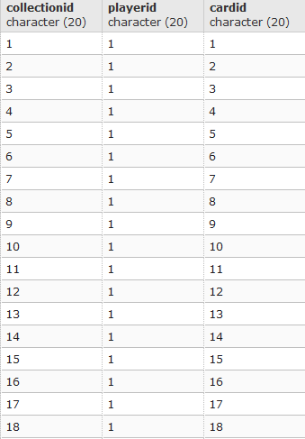

Slide 18
Player
CREATE TABLE Player (
playerID CHAR(20),
playerFirstName CHAR(20),
playerLastName CHAR(20),
playerDisplayName CHAR(20),
roundsWonToday INTEGER,
scrapTotal INTEGER,
PRIMARY KEY(playerID)
);

Slide 19
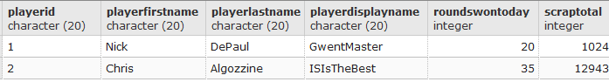

Slide 20
Leader
CREATE TABLE Leader (
leaderID CHAR(20),
leaderClass CHAR(20),
leaderName CHAR(20),
leaderAbility CHAR(200),
thanksEmote CHAR(20),
wellPlayedEmote CHAR(20),
badMoveEmote CHAR(20),
watchThisEmote CHAR(20),
dammitEmote CHAR(20),
youAreGoingDownEmote CHAR(20),
PRIMARY KEY(leaderID)
);

Slide 21
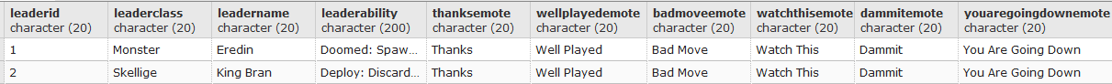

Slide 22
Credit Card
CREATE TABLE CreditCard (
creditCardID CHAR(10),
playerID CHAR(20),
creditCardNumber CHAR(16),
CSV CHAR(3),
expDate DATE,
PRIMARY KEY(creditCardID)
);

Slide 23
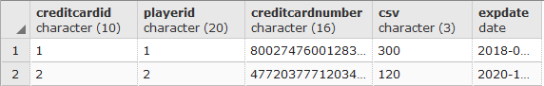

Slide 24
Player Quests
CREATE TABLE PlayerQuests (
playerQuestsID CHAR(20),
playerID CHAR(20),
questID CHAR(20),
PRIMARY KEY(playerQuestsID)
);

Slide 25
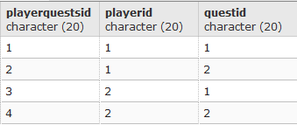

Slide 26
Quest
CREATE TABLE Quest (
questID CHAR(20),
text CHAR(20),
reward CHAR(20),
PRIMARY KEY(questID)
);

Slide 27
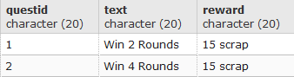

Slide 28
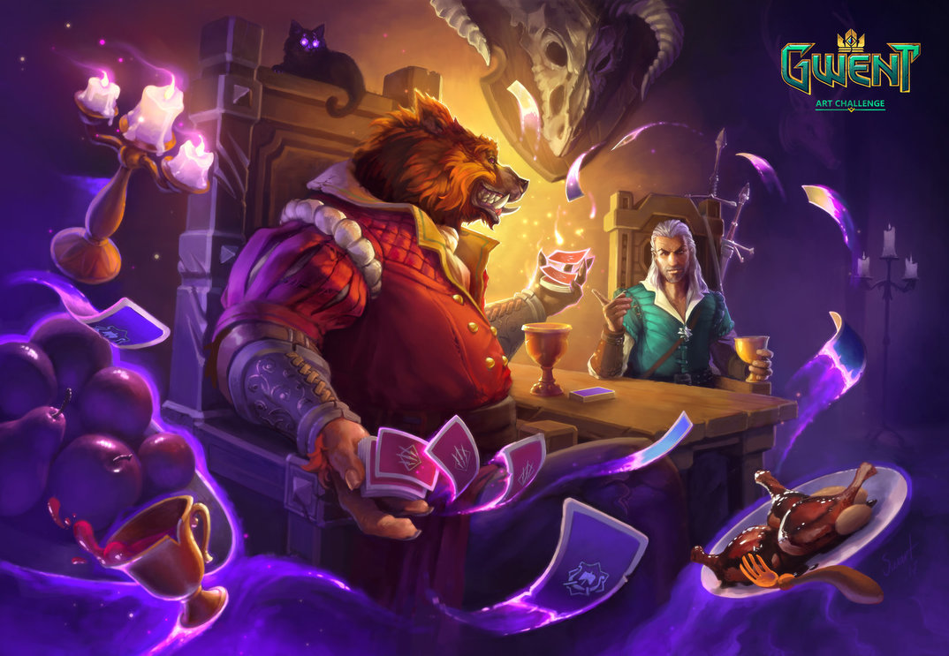
Reports

Slide 29
This will show all the factions that the minions belong to and it displays their health.
SELECT Card.cardName, Faction.factionName, Minion.health
FROM Card
RIGHT JOIN Faction ON Card.factionID = Faction.factionID
RIGHT JOIN Minion ON Card.cardID = Minion.minionID
ORDER BY Faction.factionName;

Slide 30
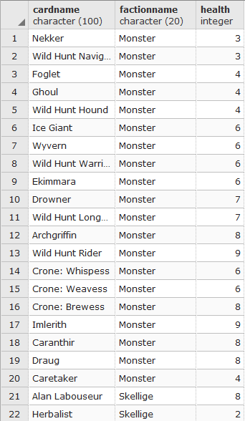

Slide 31
This displays all of the cards information in the deck
SELECT Deck.deckName, Faction.factionName, Player.playerLastName, Leader.leaderName,
Card.cardName
FROM Deck
RIGHT JOIN Faction ON Deck.factionID = Faction.factionID
RIGHT JOIN Player ON Deck.playerID = Player.playerID
RIGHT JOIN Leader ON Deck.leaderID = Leader.leaderID
RIGHT JOIN Card ON Deck.cardID = Card.cardID
ORDER BY Deck.deckName;

Slide 32
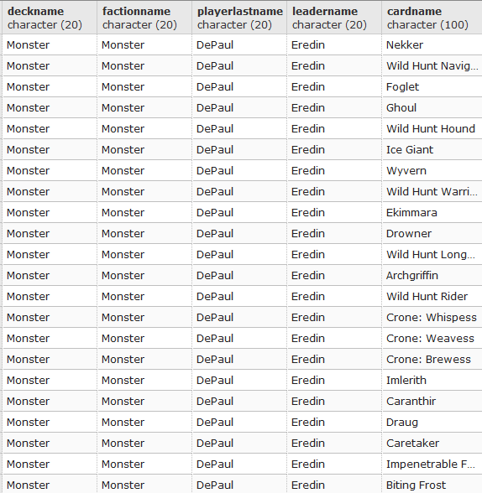

Slide 33
This shows what the player has in their collection
SELECT Player.playerLastName, Card.cardName
FROM Collection
RIGHT JOIN Player ON Collection.playerID = Player.playerID
RIGHT JOIN Card ON Collection.cardID = Card.cardID
ORDER BY Player.playerLastName;

Slide 34
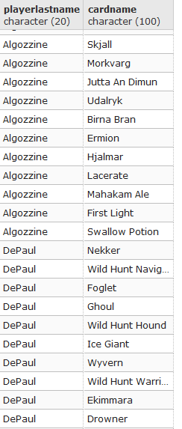

Slide 35
This shows the player’s credit card information
SELECT Player.playerLastName, CreditCard.creditCardNumber, CreditCard.CSV, CreditCard.expDate
FROM CreditCard
RIGHT JOIN Player ON CreditCard.playerID = Player.playerID
ORDER BY Player.playerLastName;

Slide 36
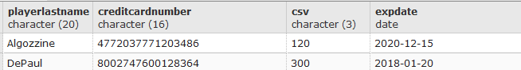

Slide 37
This shows the daily quests that the player has completed
SELECT Player.playerLastName, quest.text, quest.reward
FROM PlayerQuests
RIGHT JOIN Player ON PlayerQuests.playerID = Player.playerID
RIGHT JOIN Quest ON PlayerQuests.questID = Quest.questID
ORDER BY Player.playerLastName;

Slide 38
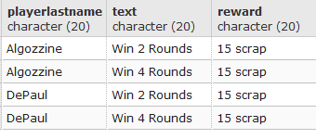

Slide 39
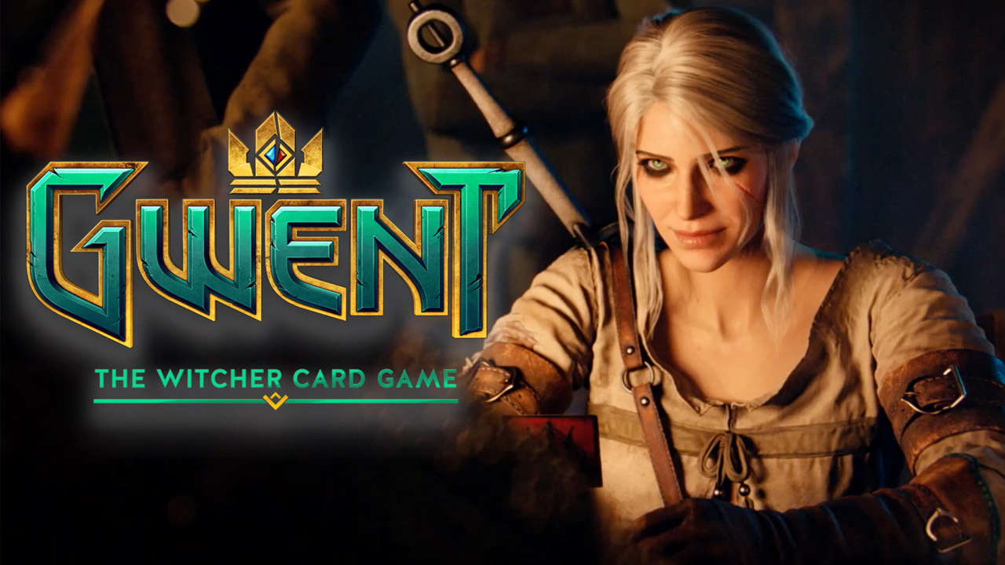
Views

Slide 40
Shows the Current Players
CREATE VIEW CurrentPlayers
AS
SELECT playerDisplayName
FROM Player;
SELECT *
FROM CurrentPlayers
ORDER BY playerDisplayName ASC;

Slide 41
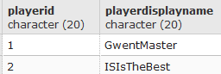

Slide 42
Shows the Leaders Class, Name, and Ability
CREATE VIEW LeaderClass
AS
SELECT leaderClass, leaderName, leaderAbility
FROM Leader;
SELECT *
FROM LeaderClass
ORDER BY leaderClass ASC;

Slide 43
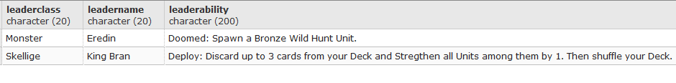

Slide 44
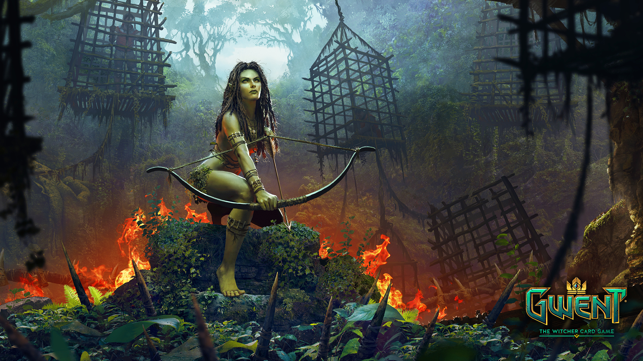
Stored Procedures

Slide 45
Add every round a player has won when they win a round
CREATE OR REPLACE FUNCTION playerRoundsWon()
RETURNS TRIGGER AS $$
DECLARE
BEGIN
IF roundsWonToday > 0 THEN
SET roundsWonToday = 1;
END IF;
RETURN new;
END;
$$ language plpgsql;

Slide 46
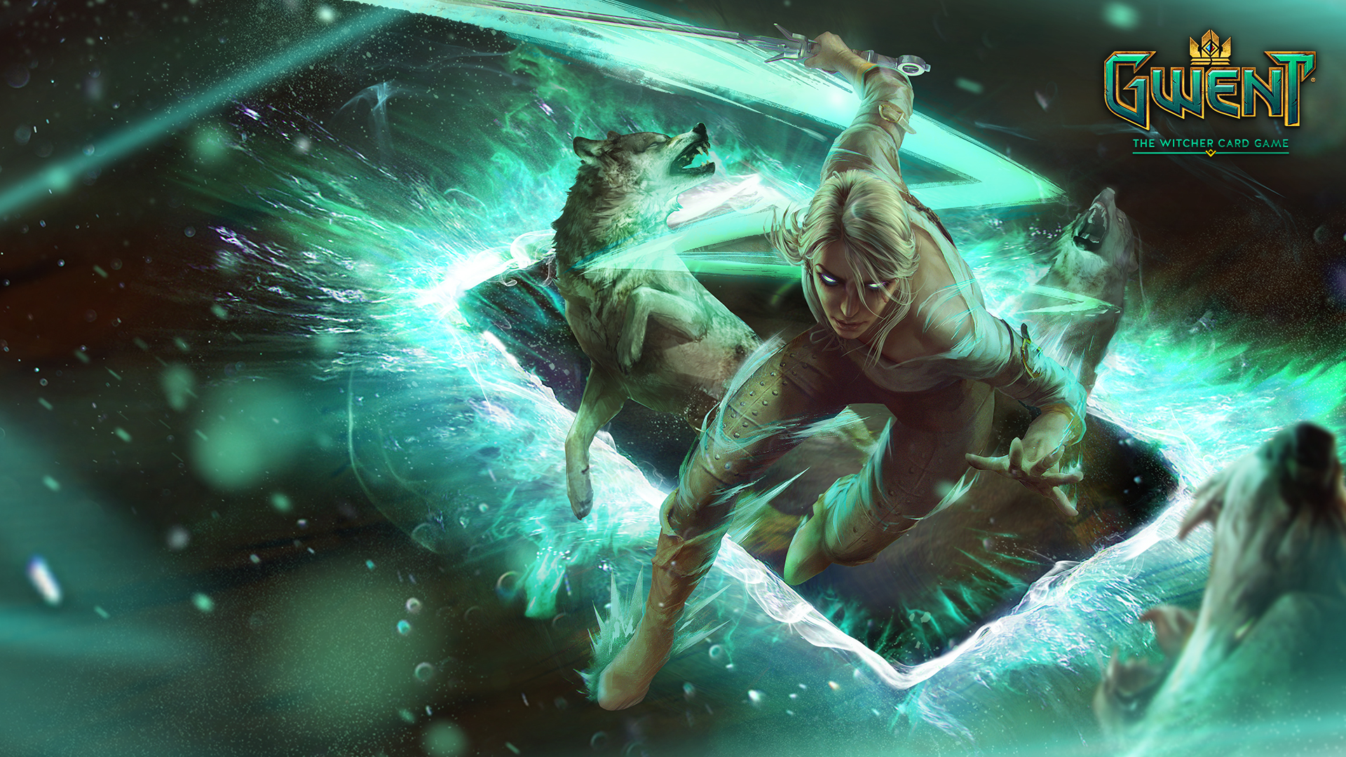
Triggers

Slide 47
This is a continuation based off of my Store Procedure
CREATE TRIGGER playerRoundsWon
BEFORE UPDATE
ON Player
FOR EACH ROW
EXECUTE PROCEDURE playerRoundsWon();

Slide 48
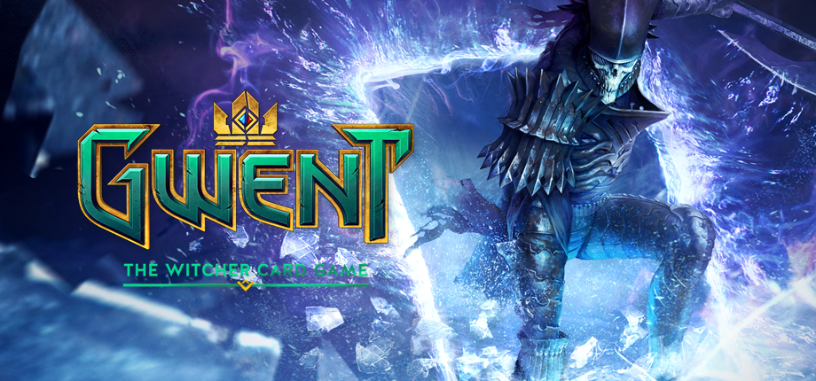
Security

Slide 49
Only grants the player access to select on all of the tables. The admin can select, insert and update on all of the tables. Of course the admin will need a password. The password is always alpaca.
CREATE ROLE Player;
GRANT SELECT ON ALL Tables IN SCHEMA PUBLIC TO Player;
CREATE ROLE Admin WITH Login Password 'alpaca';
GRANT SELECT, INSERT, UPDATE ON ALL Tables IN SCHEMA PUBLIC TO Admin;

Slide 50
Implementation Notes
The set-up of the database demonstrates the importance of the card and deck concepts within this system, and uses the player table to gathering personal information and related data to them in-game performance and collection.
The card idea is at the heart of Gwent, and this is made clear on how over half the tables in the system are tied to the card table directly. In this case, the card table holds game relevant information (stats and effects) but also displays information, such as rarity and funny card descriptions. These details can be used to encourage in-game purchases, to obtain cards ranging from the common bronze card to the difficult to get gold cards. It also will help the player grow an attachment to their collection as they have an ever-growing number of cards reflecting the time and effort they put in.

Slide 51
Implementation Notes Continued
The way the card set is used in Gwent is that it’s designed to tell the player what each card’s functionality and role is. Each card can be broken into two different categories, minions and special cards. Minions are creatures or people that are on the board and serve to provide the scores that determine the winners of each round. Special cards such as weather effects, can drastically change the course of the round, which are used to interact with the board without placing a minion. While these special cards have no unique values, creating a separate category offers potential to expand the idea; such as effects that will only work under certain requirements. Additionally, adding tables specifically for special cards and minions helps prevent every card from having multiple null values as type-specific values are prohibited. It will also decrease errors from filling in the wrong values, for example, filling in a health cost for a card that does not have that value, such as a weather effect card.

Slide 52
Implementation Notes Continued
Each card can either be used by all factions or are limited to a specific faction. Each faction has unique cards, abilities, and effects, which promotes different strategies. This encourages players to pick a faction that best suits their style of play. This creates a new level of depth in the product without adding anything that is too hard to understand. The faction table creates a place to refer to in order to separate the cards that fall under their distinct set.
Each faction is represented by multiple leaders, that have unique personalities which is characterized by emotes that can be spoken in game, and are further defined by specific abilities, even for leaders within the same faction. For example, an aggressive leader may use a nasty greeting, while a more relaxed one would be more pleasant. Also, the more aggressive leader could have an ability that will destroy an opponent’s card, while the relaxed one could pick a random card from their deck and play it.

Slide 53
Implementation Notes Continued
Each of these factors come together in the concept of a deck. The implementation of the deck concept was one that went through several versions. The final execution is a combination of related tables giving the sum-total of a deck’s value of cards, faction and leader selection. The deck is the main method by which players interact with the game, and is the core of Gwent.
An additional feature of the game lies in quests, which can be used to acquire in-game resources to get cards without spending real-world money. The PlayerQuest table ties quests to the players that have them. This allows a free-to-play style, and many players will be encouraged to pay real-world money to obtain cards faster and allow them to complete their collection of cards a lot quicker.

Slide 54
Implementation Notes Continued
As of right now, the player field is only being used to store information and a way to bring together assets, such as decks, card collection, and quests and tie them to a single player. However, this could store the in-game statistics for each player faction; such as rounds that were won, overall win rates, and storing records of games to allow players to study the way they play. While this is really limited as of right now only storing the number of games won daily, there is a lot more that can be done to enhance the game with this table. Providing tools that will offer the player a means by which to invest themselves in the game, and is another way to encourage free-to-play players to start using real-world money to speed the rate by which they earn their card collection.

Slide 55
Known Problems / Future Enhancements
One enhancement that they should make to this database would be adding a set of tables for in game effects such as rounds, and players. This change would record information and allow an analysis of gameplay to give the developers and players information in order to change tactics and balance cards more effectively. The current system does not give us this data, weakening decision making which will have users going to third party applications to improve their performance.
The player entity is not being used enough for storing information based on player behavior. If additional information is stored, including play times and activity, this will help in going after users who may be losing interest in the game by offering encouragement to continue playing; such as giving a bonus after a certain amount of playtime.

Slide 56
Known Problems / Future Enhancements Continued
Adding additional information within cards, including the card set and rate of activities performed, such as scrapping could also give information. This could be valuable information for the developer. If a certain amount of players are constantly scrapping the same card then the developer may want to change the effects on that card. Or if a card is winning too often then they may want to weaken it.
Gwent could take cues from their rival Hearthstone in player deck customization. To enhance customization, they could allow the player to create decks they have created. Right now, they only call your deck based on whatever faction it belongs to. This could help prevent players losing interest in the game because it will allow them to grow an attachment to their decks.

